Slide 1
Getting Started with Routes
Spitfire Project Management System

Slide 2
Overview
How to respond when a document is at your Seq #.
Thumbs up icon
Inbox Action bar
CC’d document
Possible route options
The Rsp and Ins fields
Understanding Routes
Parallel vs. Sequential Sequences
Pending vs. Pending Any
How Routes are Created
Manually
Through Build Route option
Through Predefined Routes

Slide 3
Route Detail Tab
On your Spitfire document.
When you create a document, you are Seq #1.
You can route the document, if desired, but not all documents need to be routed.

Slide 4
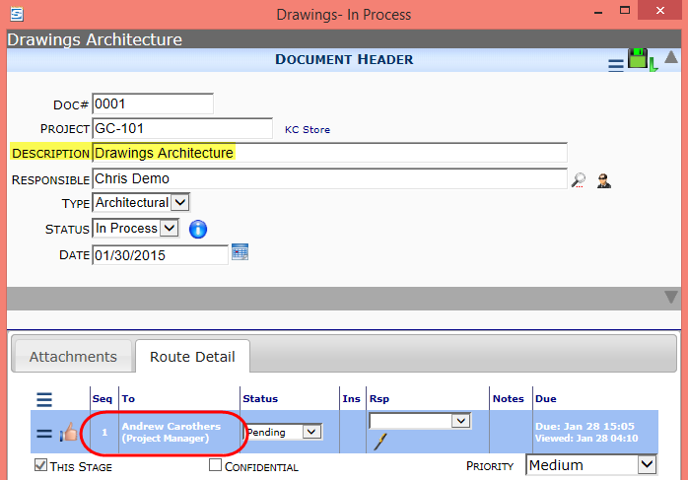
Route Sequences
Documents go from Seq # to Seq #.
If it’s at your Seq # (because you created the document or it was routed to you), it is in your Home Inbox.

Slide 5
“Thumbs Up” Your Route Row…
…to remove the document from your Home Inbox.
…to route the document to the next person, if any.
The “thumbs up” icon automatically saves your document.

Slide 6
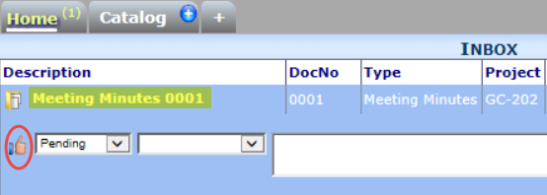
Inbox Action Bar
If appropriate, you can route a document without opening it first by clicking in the white space next to the document description and then clicking the “thumbs up”.

Slide 7
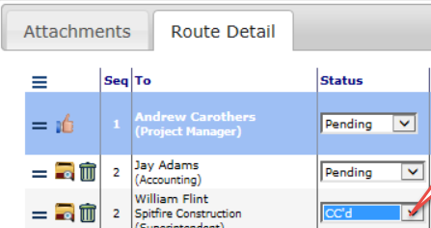
The Route CC’d Status
A document that is routed CC’d goes to the person’s Inbox (marked with a special icon), but is no longer part of the routing sequence.

Slide 8
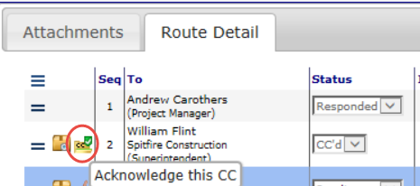
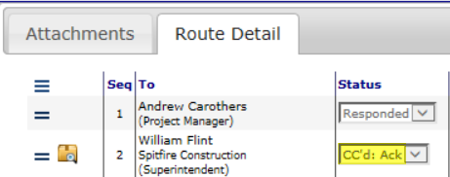
CC’d Document in the Inbox
Open the document by clicking on the special icon.
Click on the CC icon on the Route Detail tab to acknowledge the document and remove it from your Inbox.

Slide 9
Possible Route Status Options
Depending on your permission level, you may have up to four options when the document is at your Sequence.
If you do not select a route status, the “thumbs up” icon automatically selects Responded for you. Responded routes the document to the next Sequence.
But you may have other options…

Slide 10
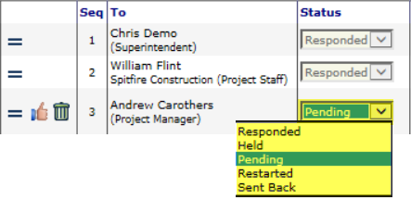
Possible Route Status Options
Held keeps the document in your Inbox, letting others know you are doing so.
Restarted removes the document from your Inbox and routes it back to Seq 1.
Sent Back removes the document from your Inbox and routes it to the previous routee (e.g., Seq 2).
The “thumbs up” icon will keep your selection.

Slide 11
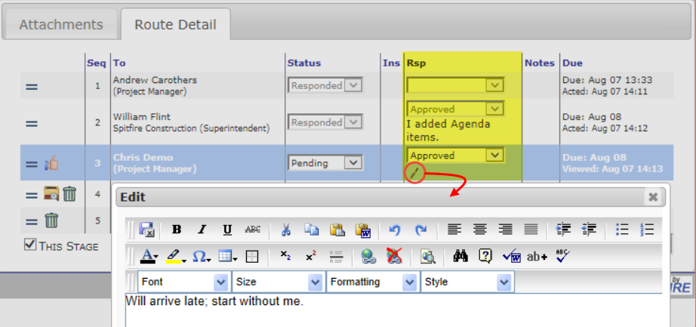
The Respond(Rsp) Field
When the document is in your Inbox, you can edit your Route row, select a Rsp from the drop-down and add a note.

Slide 12
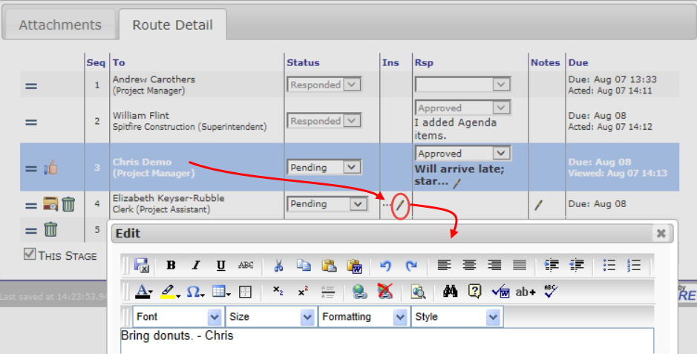
The Instruction(Ins) Field
When the document is in your Inbox and you have the right permission, you can add a note in an upcoming Ins field.

Slide 13
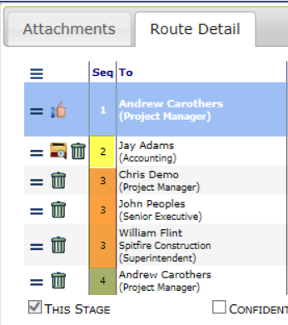
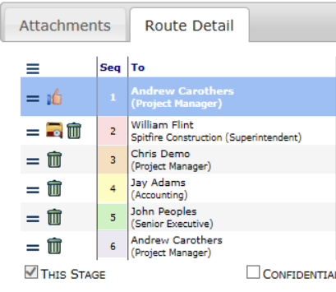
Route Sequences…
…can be parallel, sequential or a mix of the two.

Slide 14
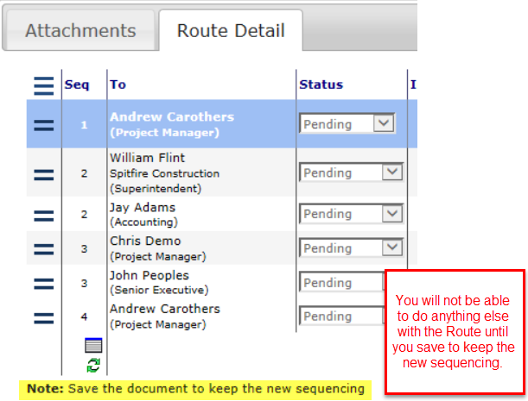
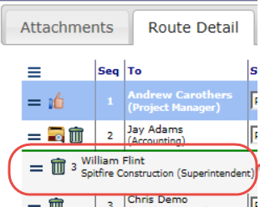
Change the Route Sequence
You can drag and drop a routee row into a different sequence.
You will not be able to do anything else with the document until you save to keep the new sequencing.

Slide 15
Pending vs. Pending Any
Parallel routees that are “Pending” will all receive the document in their Inboxes at the same time. All of them need to send the document forward in order to route the document to the next Seq.

Slide 16
Pending vs. Pending Any
Parallel routees that are “Pending Any” will all receive the document in their Inboxes at the same time. However, only one of them needs to send the document forward in order to route the document to the next sequence.

Slide 17
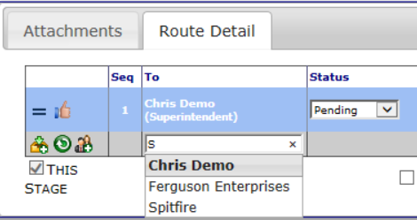
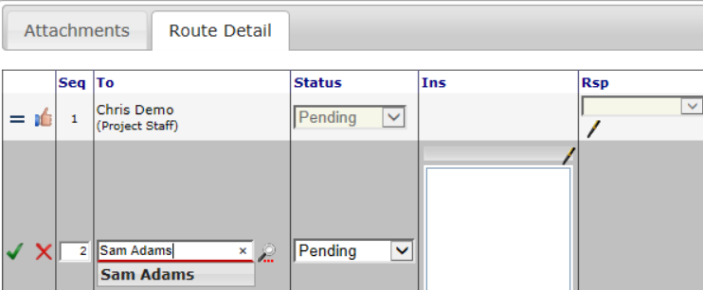
Adding a Routee
You can add people to the end of your route manually.
Type the beginning of the name and/or select it from the drop-down list.
Click the checkmark

Slide 18
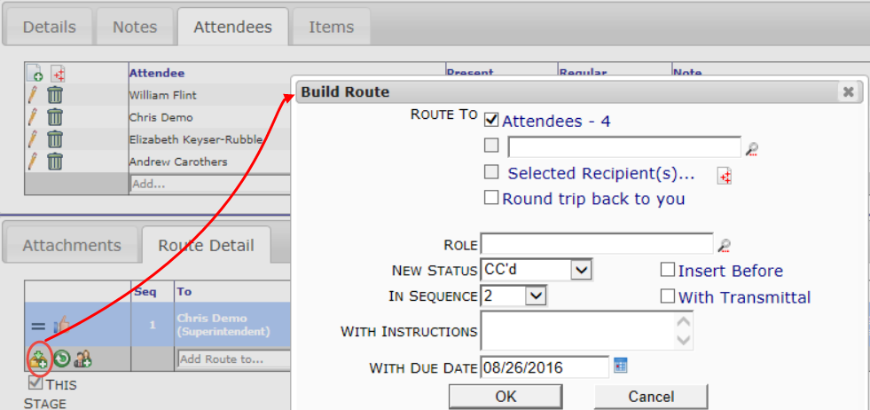
Build Route Option
Another way to add names to the Route Detail tab is the Build Route option.
Click the icon to open the Build Route dialog box, which offers shortcuts to building your route.

Slide 19
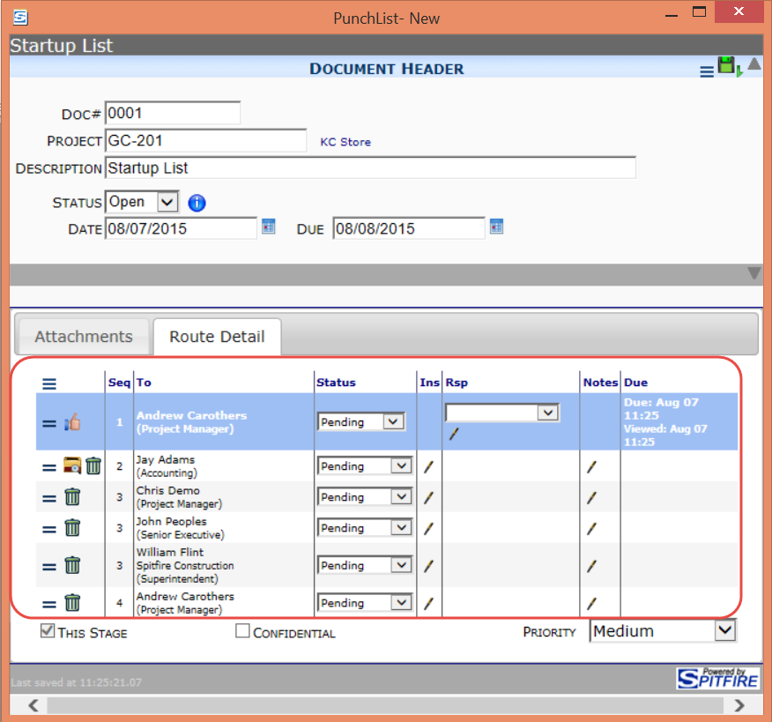
A Predefined Route
If set up, predefined routing may create the routing list on your document when you save. Usually you don’t have to change this routing.

